Slide 1
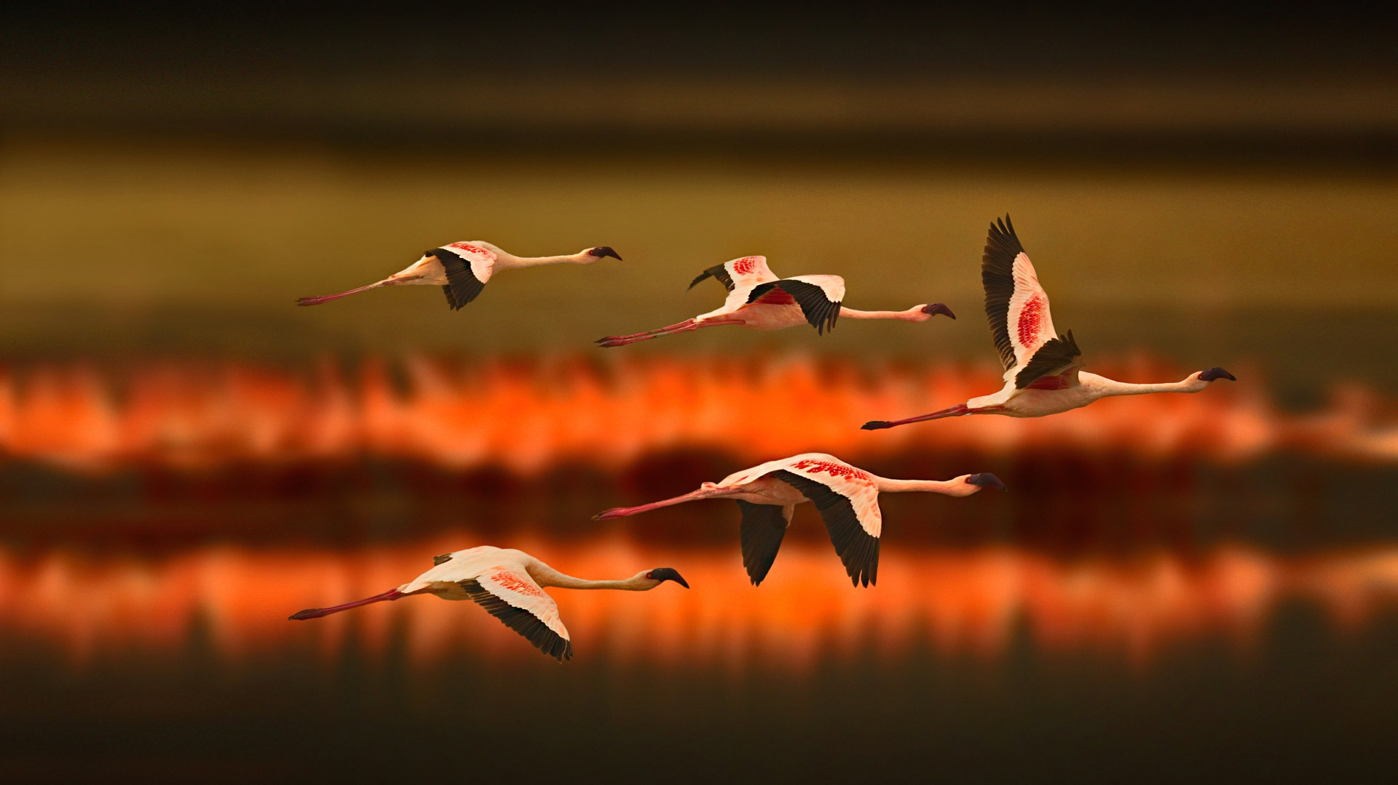

PREDICTING BIRD MIGRATION
Adarsh Raghav, Chinta Shrihan, Jarvis Prem Raj, Arnav Malhotra
E19CSE063, E19CSE026, E19CSE425, E19CSE143
Batch 13

Slide 2
Contents
Introduction
Problem
Solution
Software Requirements and tech utlizied

Slide 3
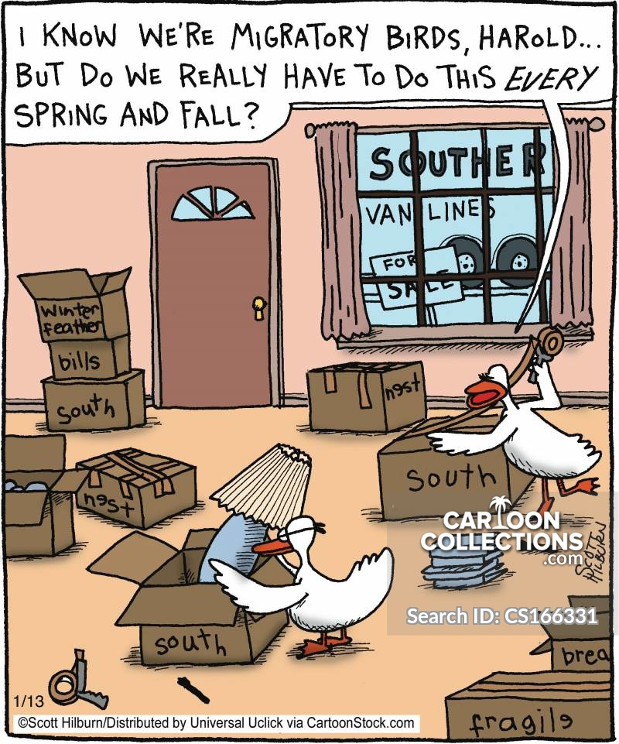
Introduction
With the help of our knowledge of Python and Machine Learning we will be predicting the migration of birds. Our main objectives would be:
To predict the location to which a certain species of birds are likely to migrate.
The time of the year at which it will migrate
Observe and analyze any changes that have occurred in the past few years.
Being able to present the trends as well as the changes in a analytical way.

Slide 4
Problem
“Climate change is leading to unpredictable ecosystem disruption for migratory birds” – Science Daily
Our world today revolves around technology, communication, services and various other dependencies. Although these may have impacted our lives to a great extent yet they have taken the toll on nature. This toll is largely shared by birds.
It was first reported in 2016 that there are nearly 400 endangered species of birds out of the 500 listed by the British Trust for Ornithology in the United Kingdom itself.

Slide 5
According to a study conducted by the University of Jerusalem, it has been stated that in a few common species of birds such as the Holarctic bird species, it has been noticed that they’re adjusting towards an earlier arrival to breeding grounds to accommodate the earlier onset of spring. This change has been brought about by global warming.
Due to such large changes in migration patterns it becomes difficult for organizations managing bird sanctuaries to be prepared for these delays.
It also leaves scientists in a dilemma and they often wonder, ‘what is really causing this change?’

Slide 6
Solution
The solution that we came up was to design such a program which could precisely predict the migration of a few common species of birds. Using our knowledge of python and machine learning we will be using large data sets recorded by various organizations and predicting bird flight patterns.

Slide 7
Tech/Resources and softwares utilized
Software’s:
Enthought Canopy
Python
Jupyter
Jupyter Lab
Spyder
Data Sets:
https://inbo.carto.com/u/lifewatch/datasets
Note: The data set is already provided in a csv file hence no conversion is required

Slide 8
Tech/Resources utilized
Dependencies:
Pandas: Used to alter and analyze data
NumPy: Used to run advanced mathematical operations on data
Matplotlib: Used to present data in an analytical way
Cartography: Can be used to import a map

Slide 9
Acknowledgement
https://drive.google.com/file/d/0ByqooCIGbyKiYXcxbmpKdWJiVWs/view
https://findingnature.co.uk/air-pollution-affects-birds/
https://www.sciencedaily.com/releases/2019/03/190305083638.htm

Slide 10
Thank You

